Slide 1
Bézier Curves

Slide 2
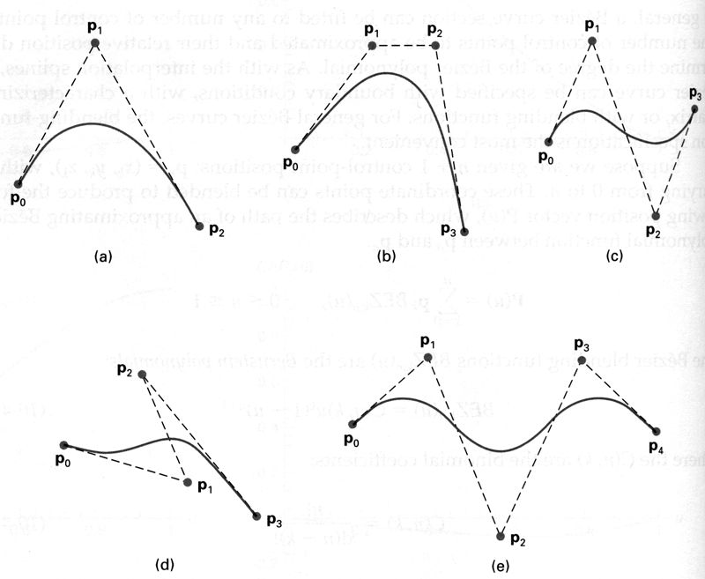
Introduction
A Bézier curve is a sequence of linear interpolations among many points.
Just as with linear interpolations, we use two control points that act as start and end points.
The other two points control the tangents at the endpoints in a geometric way.

Slide 3



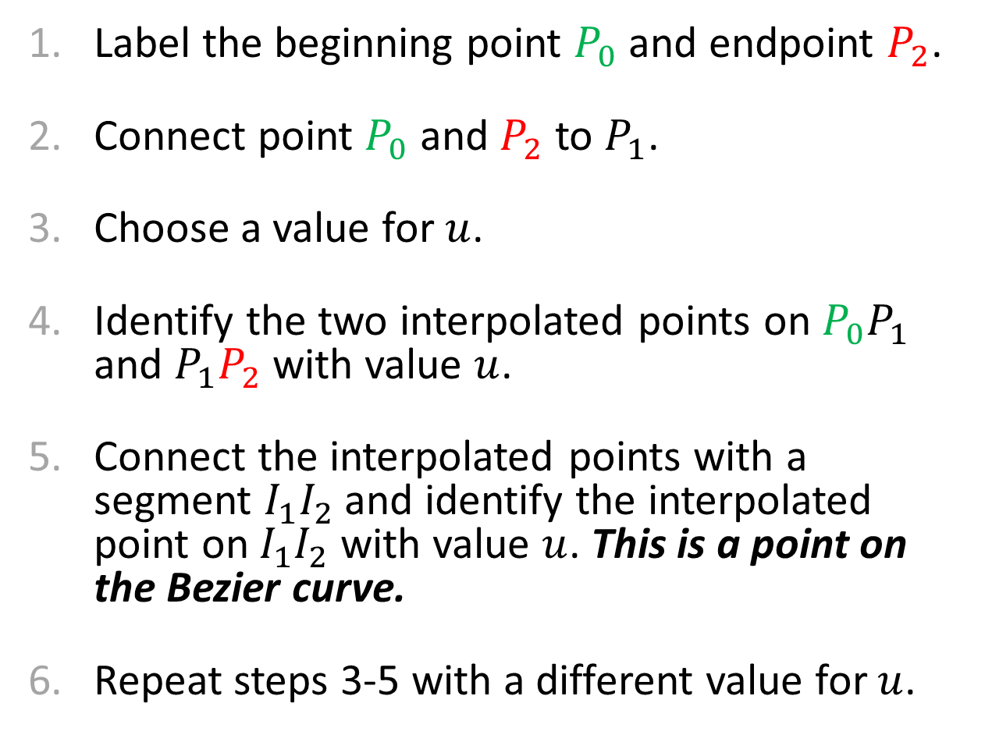



Determining Bézier Curves: 3 Points
Label the beginning point $P_{0}$ and endpoint $P_{2}$.
Connect point $P_{0}$ and $P_{2}$ to $P_{1}$.
Choose a value for $u$.
Identify the two interpolated points on $P_{0}P_{1}$ and $P_{1}P_{2}$ with value $u$.
Connect the interpolated points with a segment $I_{1}I_{2}$ and identify the interpolated point on $I_{1}I_{2}$ with value $u$. This is a point on the Bezier curve.
Repeat steps 3-5 with a different value for $u$.
$$P_{1}$$
$$u=0.5$$
$$I_{1}$$
$$I_{2}$$
$$P_{0}$$
$$P_{2}$$

Slide 4



Determining Bézier Curves: 3 Points
Label the beginning point $P_{0}$ and endpoint $P_{2}$.
Connect point $P_{0}$ and $P_{2}$ to $P_{1}$.
Choose a value for $u$.
Identify the two interpolated points on $P_{0}P_{1}$ and $P_{1}P_{2}$ with value $u$.
Connect the interpolated points with a segment $I_{1}I_{2}$ and identify the interpolated point on $I_{1}I_{2}$ with value $u$. This is a point on the Bezier curve.
Repeat steps 3-5 with a different value for $u$.
$$P_{1}$$
$$I_{2}$$
$$u=0.25$$
$$I_{1}$$
$$P_{0}$$
$$P_{2}$$

Slide 5



Determining Bézier Curves: 3 Points
Label the beginning point $P_{0}$ and endpoint $P_{2}$.
Connect point $P_{0}$ and $P_{2}$ to $P_{1}$.
Choose a value for $u$.
Identify the two interpolated points on $P_{0}P_{1}$ and $P_{1}P_{2}$ with value $u$.
Connect the interpolated points with a segment $I_{1}I_{2}$ and identify the interpolated point on $I_{1}I_{2}$ with value $u$. This is a point on the Bezier curve.
Repeat steps 3-5 with a different value for $u$.
$$P_{1}$$
$$I_{1}$$
$$u=0.75$$
$$P_{0}$$
$$I_{2}$$
$$P_{2}$$

Slide 6




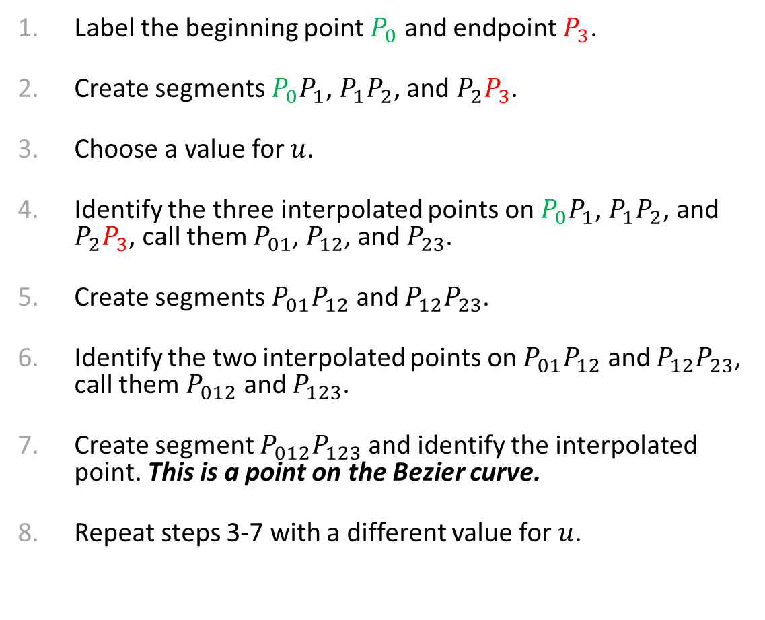






Determining Bézier Curves: 4 Points
Label the beginning point $P_{0}$ and endpoint $P_{3}$.
Create segments $P_{0}P_{1}$, $P_{1}P_{2}$, and $P_{2}P_{3}$.
Choose a value for $u$.
Identify the three interpolated points on $P_{0}P_{1}$, $P_{1}P_{2}$, and $P_{2}P_{3}$, call them $P_{01}$, $P_{12}$, and $P_{23}$.
Create segments $P_{01}P_{12}$ and $P_{12}P_{23}$.
Identify the two interpolated points on $P_{01}P_{12}$ and $P_{12}P_{23}$, call them $P_{012}$ and $P_{123}$.
Create segment $P_{012}P_{123}$ and identify the interpolated point. This is a point on the Bezier curve.
Repeat steps 3-7 with a different value for $u$.
$$P_{1}$$
$$P_{01}$$
$$P_{2}$$
$$u=0.5$$
$$P_{012}$$
$$P_{01}$$
$$P_{123}$$
$$P_{0}$$
$$P_{23}$$
$$P_{3}$$

Slide 7




Determining Bézier Curves: 4 Points
Label the beginning point $P_{0}$ and endpoint $P_{3}$.
Create segments $P_{0}P_{1}$, $P_{1}P_{2}$, and $P_{2}P_{3}$.
Choose a value for $u$.
Identify the three interpolated points on $P_{0}P_{1}$, $P_{1}P_{2}$, and $P_{2}P_{3}$, call them $P_{01}$, $P_{12}$, and $P_{23}$.
Create segments $P_{01}P_{12}$ and $P_{12}P_{23}$.
Identify the two interpolated points on $P_{01}P_{12}$ and $P_{12}P_{23}$, call them $P_{012}$ and $P_{123}$.
Create segment $P_{012}P_{123}$ and identify the interpolated point. This is a point on the Bezier curve.
Repeat steps 3-7 with a different value for $u$.
$$P_{1}$$
$$P_{12}$$
$$P_{2}$$
$$u=0.25$$
$$P_{123}$$
$$P_{01}$$
$$P_{23}$$
$$P_{012}$$
$$P_{0}$$
$$P_{3}$$

Slide 8






Determining Bézier Curves: 4 Points
Label the beginning point $P_{0}$ and endpoint $P_{3}$.
Create segments $P_{0}P_{1}$, $P_{1}P_{2}$, and $P_{2}P_{3}$.
Choose a value for $u$.
Identify the three interpolated points on $P_{0}P_{1}$, $P_{1}P_{2}$, and $P_{2}P_{3}$, call them $P_{01}$, $P_{12}$, and $P_{23}$.
Create segments $P_{01}P_{12}$ and $P_{12}P_{23}$.
Identify the two interpolated points on $P_{01}P_{12}$ and $P_{12}P_{23}$, call them $P_{012}$ and $P_{123}$.
Create segment $P_{012}P_{123}$ and identify the interpolated point. This is a point on the Bezier curve.
Repeat steps 3-7 with a different value for $u$.
$$u=0.75$$
$$P_{1}$$
$$P_{12}$$
$$P_{2}$$
$$P_{01}$$
$$P_{012}$$
$$P_{0}$$
$$P_{123}$$
$$P_{23}$$
$$P_{3}$$

Slide 9
Determining Bézier Curves: 4 Points
Label the beginning point $P_{0}$ and endpoint $P_{3}$.
Create segments $P_{0}P_{1}$, $P_{1}P_{2}$, and $P_{2}P_{3}$.
Choose a value for $u$.
Identify the three interpolated points on $P_{0}P_{1}$, $P_{1}P_{2}$, and $P_{2}P_{3}$, call them $P_{01}$, $P_{12}$, and $P_{23}$.
Create segments $P_{01}P_{12}$ and $P_{12}P_{23}$.
Identify the two interpolated points on $P_{01}P_{12}$ and $P_{12}P_{23}$, call them $P_{012}$ and $P_{123}$.
Create segment $P_{012}P_{123}$ and identify the interpolated point. This is a point on the Bezier curve.
Repeat steps 3-7 with a different value for $u$.
$$P_{1}$$
$$P_{2}$$
$$P_{0}$$
$$P_{3}$$

Slide 10
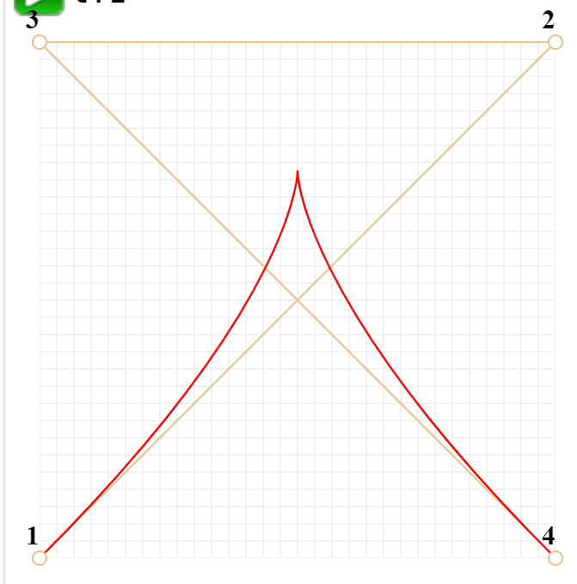
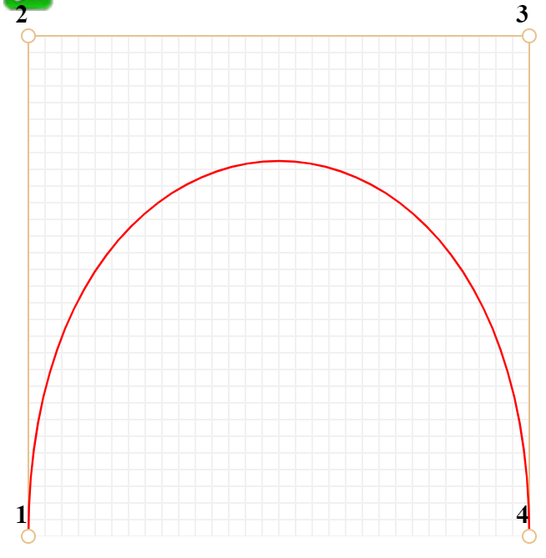
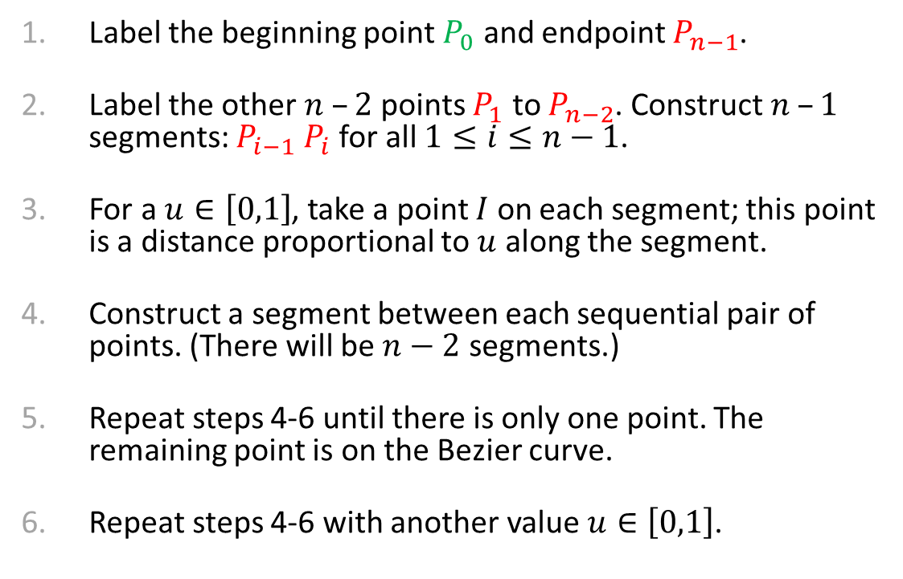
Determining Bézier Curves: $n$ Control Points
Label the beginning point $P_{0}$ and endpoint $P_{n−1}$.
Label the other $n –2$ points $P_{1}$ to $P_{n−2}$. Construct $n –1$ segments: $P_{i−1} P_{i}$ for all $1≤i≤n−1$.
For a $u∈\left[0,1\right]$, take a point $I$ on each segment; this point is a distance proportional to $u$ along the segment.
Construct a segment between each sequential pair of points. (There will be $n−2$ segments.)
Repeat steps 4-6 until there is only one point. The remaining point is on the Bezier curve.
Repeat steps 4-6 with another value $u∈\left[0,1\right]$.
This curve orders points lexicographically: in two dimensions, lexicographic means considering x-values then y-values.
In Step 2: different orderings of points will achieve different curves.

Slide 11
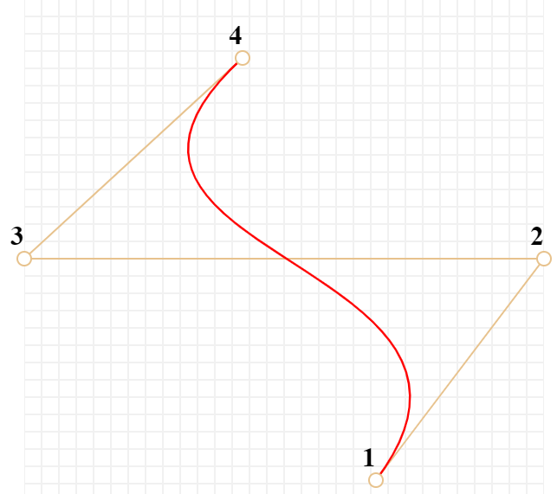
Bézier Curve Properties
Constructing a Bezier Curve (Visually)
Another Link
The first and last control points are interpolated.
The tangent to the curve at the first control point is along the line joining the first and second control points.
The tangent at the last control point is along the line joining the second to last and last control points
The curve lies entirely within the convex hull of its control points.
(Convex hull: smallest convex polygon encompassing the control points; imagine a rubber band stretched around all control points.)

Slide 12
Scratch

